Slide 1
Virtual Credit Voyage

Slide 2
Welcome!
This workshop is based on content developed by ideas42 with generous support from Capital One
*This workshop is not intended to provide financial advice or guidance; instead we’re here to help provide key terms and share best practices that can help improve your relationship with money. Any opinions or advice is of the organization and not necessarily Capital One’s.
Notes:
Welcome! Today is the beginning of your Credit Voyage.

Slide 3
Virtual Webinar
Muted lines
Raise your hand if you’d like to be unmuted
Type on the chat box any time!

Slide 4
Type your name in the “Chat” function
Notes:
Host: We will also be using the “Chat” feature on zoom throughout the presentation. Please take a moment to locate the chat button on your computer or device.
Lets get your feet wet with the chat function! Please type in your name in the chat function!

Slide 5
What you’ll need during this workshop:
Pen/pencil
Paper
or -
Something to keep notes on
Preparing for the workshop
Notes:
We ask that you grab a pen/ pencil and paper or something to keep notes on. You will be working on your own personalized plan guided by our conversation today. Please take a minute to locate what you will use to take notes. Once you are ready to move on type READY on the chat

Slide 6
Where You’ll Go Along Your Journey
Step 1: Come to the “Credit Voyage” Training (DONE!)
Step 2: Choose Your Destination
Step 3: Learn Why Credit Matters & Ways to Improve It
Step 4: Chart Your Next Steps
After Today: Continue your journey to your Destination!
Notes:
Here’s a preview of which steps we’ll take. You’ve already accomplished the first one - great work! Coming up, we’ll choose your Destination, which is also your goal.
Next, you’ll learn why credit is so important, and some ways to improve it.
After that, you’ll make a plan to improve it by filling in those blank boxes – 5, 6, and 7 with your next steps.
After today, you can take those steps to continue on the road to your destination. We’ll talk more about that later.

Slide 7
Step 2
Choose Your Destination
Notes:
Now, let’s choose our destinations.

Slide 8
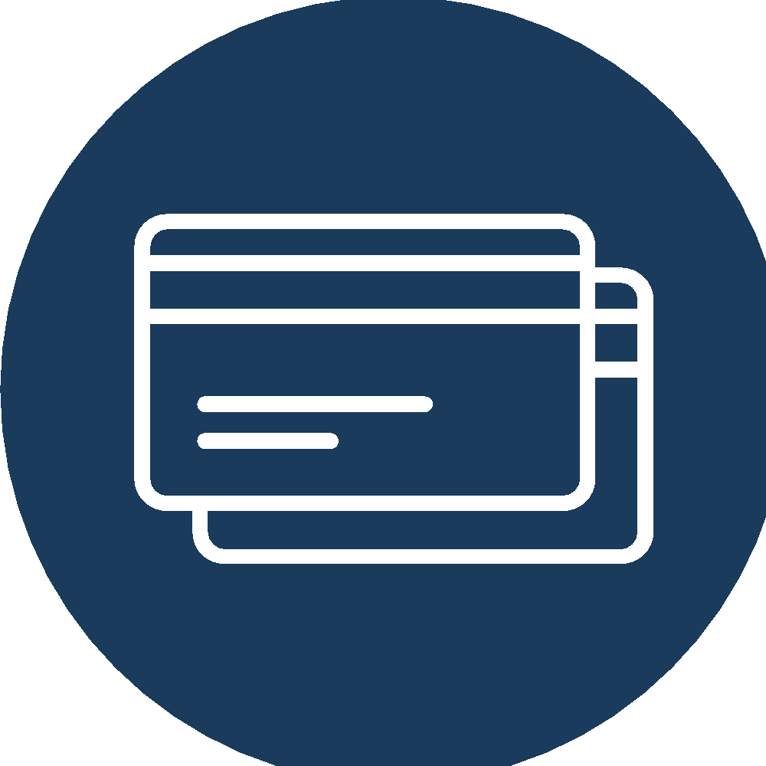
Journeys are Tough, but the Destination is Worth it.
Your destination is your goal.
What goal could strong credit help me reach?
Homeownership
Owning or Renting a Home
Owning or Leasing a Car
Qualifying for new credit cards
Notes:
[Note to Facilitator: PREP: Fill in your Destination in the text box where it currently reads Home Ownership]
Journeys can be tough. Things come up - unexpected expenses, changes in employment - that can make the path harder. But if you keep persisting towards your Destination, it’s worth it.
But, first you need to know, what is your Destination?
In other words, what goal could strong credit help you reach?
There are some examples up here – maybe you want to own or rent a home, or maybe you want to own or lease a car.
Maybe you want to qualify for a new credit card.
Or maybe you want to get a loan for your business.
My goals is [Note to FAE: read your goal]
Take a minute and think about what your destination is.
Write down your destination on your map.
Next we’ll have a chance to discuss our destinations.

Slide 9
What’s YOUR Destination?
Why is this important to you?
Type your destination in the “Chat” function
Notes:
We miss hearing from you guys! Please use the chat box to let us know what you chose as your destination.
Host: type in your destination in the chat function and include why it is important. Share a personal example while waiting for responses. Acknowledge some of the responses and how they might relate to having a strong credit score.
[Note to Facilitator: Ask the group]: What’s your Destination? Why is this important to you?

Slide 10
Step 3
Why Credit Matters
Notes:
Facilitator:
We’re already on Step 3. During this step, we’ll learn more about why credit is so important and strategies you can take that could help improve or build your credit.
You can put your map and paper to the side to focus on the content, and when questions come up, please type them into the chat box. We will make sure to address your questions.

Slide 11
What is a Credit Score?
A good credit score can qualify you for loans to …
Usually, a higher score gives you access to better interest rates
CREDIT SCORE:
A number that summarizes how likely lenders think you are to repay credit. Most credit scores range from 300-850.
Get a credit card
Buy a car
Buy a house
Pay for higher
education
Source: CFPB website 2019
‹#›
Notes:
CREDIT SCORE:
A number that summarizes how likely lenders think you are to repay credit. Most credit scores range from 300-850.
A good credit score can qualify you for loans to get a credit card, buy a car, buy a house, and pay for higher education.
Usually, a higher score gives you access to better interest rates

Slide 12
Quick Check-in
Has anyone here seen their credit score?
Don’t worry if you’ve got a way to go. We all start somewhere.
No matter what your score is today, you’re in the right place to improve it!
Respond on chat
Notes:
Facilitator -
Quick Check-in
Has anyone here seen their credit score?
Host: Set up poll asking how many individuals have checked their credit score. Let facilitator know the response to poll.
[Note to Facilitator: Wait for poll. Thank client for their response]
[Note to Facilitator : CLICK and read “don’t worry…”]p
[Note to Facilitator : CLICK read “No matter what..”]
Checking your Credit Score can be a helpful way to track your progress towards your destination. Let’s talk about how you can check your score.

Slide 13
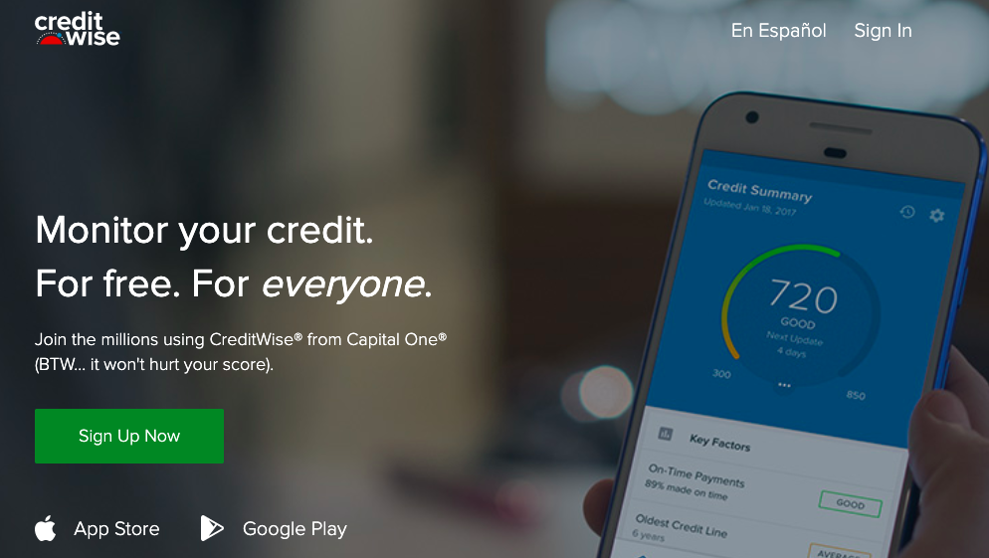
Check Your Progress
Check Your Credit Score through CreditWise from Capital One, or by using other credit monitoring tools.
Notes:
One place where you can go is Creditwise.com. There are also lots of other credit monitoring tools. You can monitor your credit score and check the accounts that are reporting on your credit report through creditwise. There are tools within the app
Now, I’m going to share a story that shows the importance of credit scores.

Slide 14
A Story About Why Credit Matters
Ms. Garcia and Mr. Jones both want to buy the same car.
Notes:
Ms. Garcia and Mr. Jones both want to buy the same kind of car ( a Toyota Camry).

Slide 15
A Story About Why Credit Matters
They both apply for and receive a 3-year loan for $10,000.
$
$
$10,000, 3 years
$10,000, 3 years
Notes:
They both apply for and receive a 3-year loan for $10,000.

Slide 16
A Story About Why Credit Matters
After 3 years,
Mr. Jones has paid almost $3,000 more than Ms. Garcia.
What happened?
Send responses by chat!
Type your response in the “Chat” function
Notes:
After 3 years, Mr. Jones has paid almost $3,000 more than Ms. Garcia.
[Note to Facilitator : Ask clients: Why? What happened? [CLICK] [Wait and see if anyone responds].
Let’s see why Mr. Jones ended up paying so much more.
Ask participants to respond via chat.

Slide 17
A Story About Why Credit Matters
Mr. Jones’
420 credit score qualified him for a
high 20% interest rate.
He paid $13,378.
Ms. Garcia’s 720 credit score qualified her for a
low 3.5% interest rate.
She paid $10,548.
Notes:
CLICK
Read about Mr. Jones
CLICK
Read about Ms. Garcia

Slide 18
Cost of Borrowing Money (Interest) Can Be Affected by Two Main Factors
Interest
Rate
Cost of
Borrowing Money
or
Time to Pay Off Debt
Source: (2019). U.S. Financial Health Pulse. Financial Health Network.
Notes:
The cost of borrowing money (often called interest) can be affected by two main factors
CLICK
Interest rates, [CLICK] and the time to pay off one's debt (the length of a loan) [CLICK 2 TIMES] can impact the total cost of borrowing money.

Slide 19
Higher Credit Scores Can Make it Cheaper to Borrow
Credit
Score
Interest
Rate
Cost of
Borrowing Money
AND, higher credit scores can increase the chances that you’ll get access to credit!
Notes:
[Note to Facilitator : Explain slide in minimal detail].

Slide 20
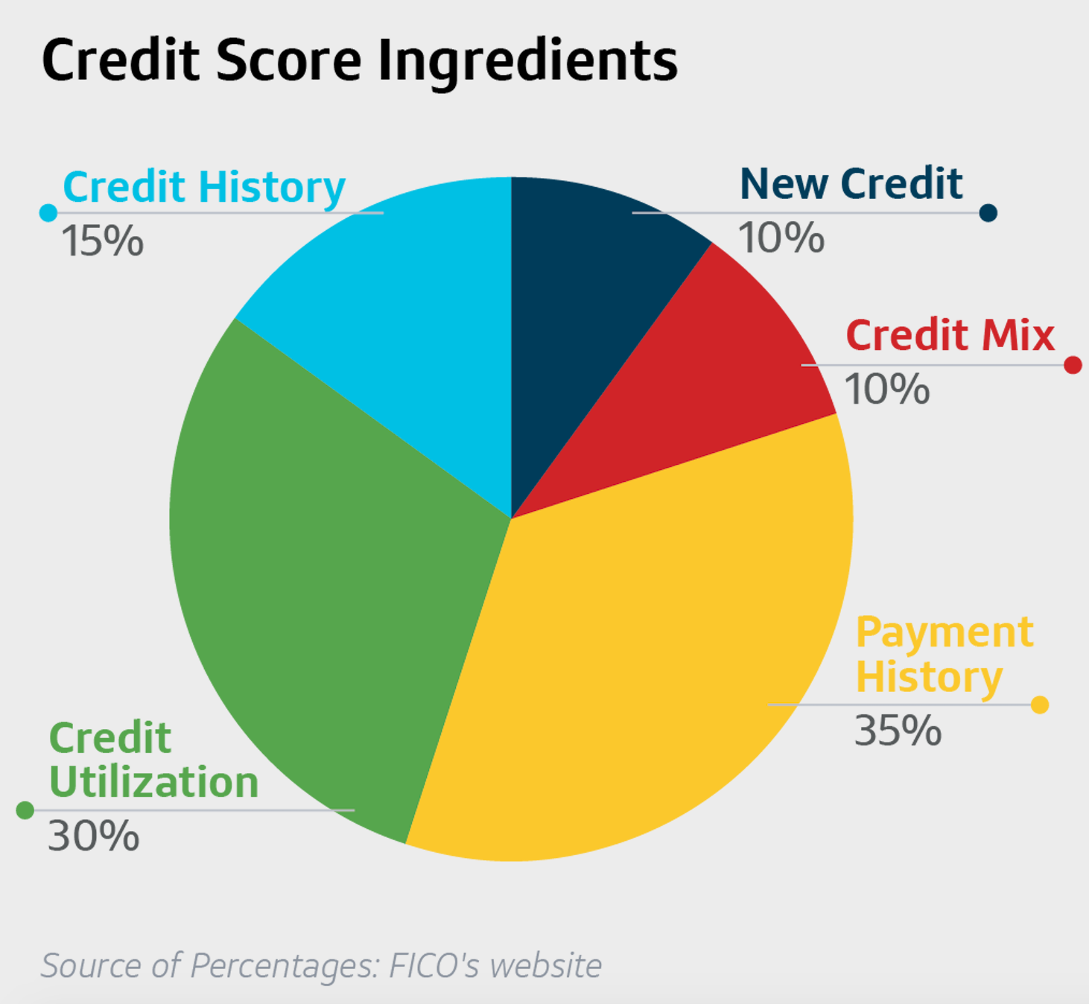
A Strong Credit Score Has Five Ingredients
35%: Payment History is whether you’ve paid consistently and on-time in the past.
30%: Credit Utilization is the percentage of your available credit (aka your limit) that you’ve spent, or borrowed.
15%: Credit History is the length of time each account’s been open and time since the account’s most recent action.
10%: New Credit tracks whether you’ve opened up new lines of credit.
10%: Credit Mix refers to your mix of different kinds of credit – like credit cards, or student loans.
Notes:
Overall, there are five ingredients that can make a score strong that stay pretty much consistent.
CLICK The first and the biggest category is your payment history - in other words, whether you’ve paid on-time in the past. It’s 35% of your total credit score.
CLICK Number two is credit utilization - the percentage of your available credit that you’ve spent or borrowed. This makes up 30 percent of your credit score.
We’ll talk much more about credit utilization later on.
Let’s pause here to realize something big: These first two ingredients make up nearly two-thirds of your score. So, if you pay your bills on time and don't carry big balances, you're two-thirds of the way toward a good credit score.
CLICK. The third factor is the length of your credit history - which is the length of time each account has been open and the length of time since the account's most recent action. It makes up 15% of your total credit score.
CLICK. The fourth factor is new credit, which is whether you’ve opened up new lines of credit recently. That makes up 10 percent.
CLICK. Finally, the fifth factor is your credit mix, which is 10 percent of your score. This looks at whether you have a mix of different types of credit - like loans and credit cards.

Slide 22
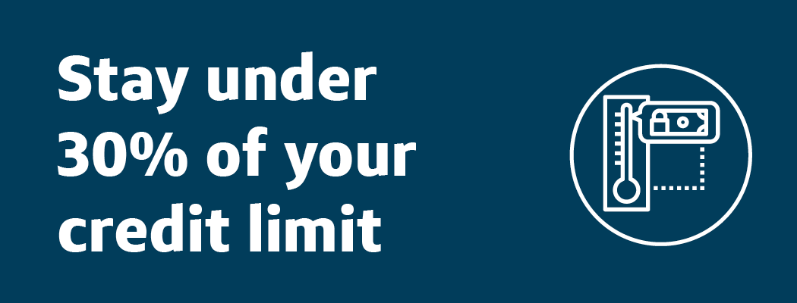
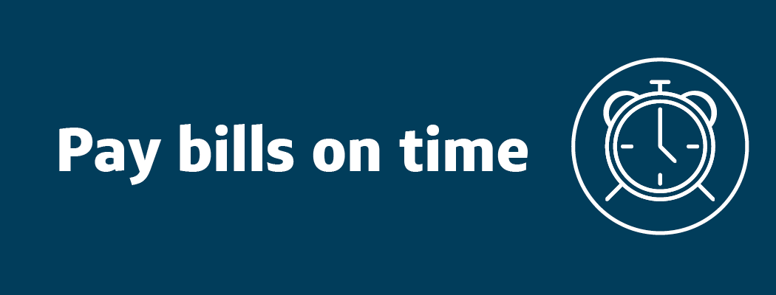
It Takes Time To Build a Strong Credit Score
After you first take out debt, it can take months or years to build a strong credit score.
Keeping your oldest account open and active
Staying under 30% of your credit utilization
Repaying consistently and on time.
Months or Years
Source: (2019). U.S. Financial Health Pulse. Financial Health Network.
Notes:
Knowing what makes up our credit score is important, it’s also important to know that it can take time to build a strong credit score.
After you first take out debt, it can take months or years of…
Repaying consistently and on time
Staying under 30 percent of your credit utilization
Keeping your oldest account open and active
To build a strong credit score.

Slide 23
But Taking Out Debt Isn’t Always The Best Strategy
Debt can be bad if…
…it’s attached to an expensive, high interest rate, it will take a long time to repay, and you don’t think you will have the money to pay it down.
Debt can help you strengthen your credit score if…
…you’re able to get a low interest rate, you can pay it off quickly, and it helps you build a history of paying consistently and on time.
Information Source: (March, 2019) Understand your credit score. CFPB. https://pueblo.gpo.gov/CFPBPubs/pdfs/CFPB117.pdf
Notes:
[Note to Facilitator : Read slide.
An example of bad debt might be if you were to open up a credit card with a high interest rate, and max it out knowing that you don’t have the money to pay it off right now.
An example of good debt might be a car loan with a reasonable interest rate that you’re able to pay off quickly.
If you DO choose to take out debt, paying more than the minimum can make it easier to pay it off quickly.

Slide 24
Paying More Than the Minimum Can Have a Huge Impact on Debt
Name | Initial Balance | Interest Rate | Monthly Payment | Interest Paid | Years to Pay Off
Mr. Lewis | $2,500 | 18% | $25 (minimum) | $4,828 | 19
Ms. Davis | $2,500 | 18% | $35 | $2,356 | 10
Ms. Clark | $2,500 | 18% | $125 | $444 | 2
Notes:
Let’s consider the example of Mr. Lewis, Ms. Davis, and Ms. Clark. Imagine they each have a credit card debt of $2,500 and an interest rate of 18%.
Mr. Lewis pays the minimum on his monthly payments.
Ms. Davis pays the minimum plus $10 on her monthly payments.
Ms. Clark pays the minimum plus $100 on her monthly paym ents.
By only paying the minimum, Mr. Lewis will pay twice as much as Ms. Davis and ten times as much as Ms. Clark. Additionally, it will take Mr. Lewis twice as long as Ms. Davis to pay off the debt and ten times as long as Ms. Clark to pay it off.

Slide 25
By paying more than the minimum, Ms. Clark pays off her loan in 2 years with minimal interest.
By paying the minimum, Mr. Lewis pays $4384 more than Ms. Clark, and it takes him almost 10X longer to pay it off.
Time to Pay Off Debt
Cost of
Borrowing Money
Notes:
By paying more than the minimum, Ms. Clark pays off her loan in 2 years with minimal interest.
By paying the minimum, Mr. Lewis pays $4384 more than Ms. Clark, and it takes him almost 10X longer to pay it off.

Slide 26
Group Discussion
Has anything surprised you so far?
What will you remember tomorrow?
Type your responses in the Chat function
Notes:
Host: Please share anything that surprised you during the previous section. What might you remember tomorrow?

Slide 27
Step 4
Charting Next Steps!
‹#›

Slide 28
Instructions:
During this next section, we’ll review Four Strategies that can help you strengthen your credit.
As we review them, think about one strategy you’d most like to pursue - the one that feels most relevant to your life.
Not all of them will be for everyone, and we’ll help you choose.
Notes:
[Note to FAE: Read slide].
Let’s take a look at the four strategies that can help you strengthen your credit!

Slide 29
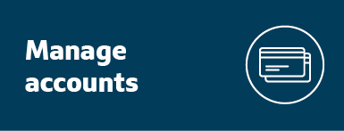
Let's Choose a Strategy

Slide 30
#1: Start Building A Credit History
Having a credit history and score can be important to accessing financial opportunities in the future. Without either, you can be limited in your ability to achieve your financial goal.
With this strategy, you will work towards building a credit history, starting with considering a secured card.
New to Credit? You’re not alone: Over 25 Million American adults don’t have a credit history.
Information Source: (2015). 45 million Americans are living without a credit score. CNBC
Notes:
As we’ve talked about, having a credit history and score can be important to accessing financial opportunities and achieving your financial goal.
With this strategy, you will work towards building a credit history, starting by considering a secured card.
If you’re new to credit, you’re not alone. According to a 2015 study by the Consumer Financial Protection Bureau, over 25 Million Americans don’t have credit histories. Many of us may be here because we haven’t built a credit history. We’re all starting a voyage today, so today is a great time to start building credit if you’re new to it.

Slide 31
#2: Improve Payment History
A single missed payment can drop your credit score by as many as 100 points; your payment history is an important factor in calculating credit scores.
With this strategy, you’ll be working towards paying your bills consistently and on-time.
Information Source: (March, 2019) Understand your credit score. CFPB. https://pueblo.gpo.gov/CFPBPubs/pdfs/CFPB117.pdf
Notes:
Pursuing this strategy could have a big impact on your credit score.
Since your payment history makes up 35 percent of your credit score, a single missed payment can reduce your credit score by as many as 100 points.
With this strategy, you’ll be working towards paying your bills consistently and on-time.
If you don’t have the money right now to pay the minimum on your card, this strategy also has tips for how to make saving easier.

Slide 32
#3: Stay Under 30% of your Credit Limit
Keeping credit card utilization (the total amount that you charge DIVIDED BY your the sum of your credit limits) below 30 percent can boost your credit score significantly.
With this strategy, you’ll learn tactics to stay under 30 percent of your credit limit.
Information Source: (March, 2019) Understand your credit score. CFPB. https://pueblo.gpo.gov/CFPBPubs/pdfs/CFPB117.pdf
Notes:
Credit card utilization is the total amount that you charge in a period divided by your total credit limit.
Keeping your overall credit card utilization below 30 percent and the utilization on individual cards below 30 percent can boost your credit score. For example, if your credit limit is $1,000, and you charged $300 to your credit card, your overall credit utilization 3p0% .
If you have more than one credit card, try to keep your utilization on each card below 30 percent, and your combined balances lower than 30 percent. Both of these numbers can affect your score.
With this strategy, you’ll learn tactics to stay under 30 percent of your credit limit.

Slide 33
#4: Manage Accounts
Having a longer account history, a mix of accounts, and fewer inquiries can moderately affect your credit score.
With this strategy, you’ll work towards maintaining old accounts and opening new accounts or credit lines with caution.
Information Source: Credit Checks: (2019). What are credit inquiries and how do they affect your FICO® Score? myFico
Notes:
Having a longer account history, a mix of accounts, and fewer inquiries on your account can moderately affect your score.
With this strategy, you’ll work towards maintaining old accounts and opening new accounts or credit lines with caution.
[Optional] Here’s a little more context: Both old credit and new credit are important. In particular, you want to keep your oldest account open, because your credit history is an important part of your credit score. If your oldest account also is a high-interest account, try to keep it active, but don’t charge too much money with it. If you’re thinking about opening a new line, be careful -- opening a new line of credit can temporarily drop your score. And opening up too many new lines at once can suggest you’re in financial trouble. Credit inquiries, like those that come from applying for a car loan or credit card, last on your credit report for two years.

Slide 34
Poll Question: Which strategy did you choose?

Slide 35
On our paper ...
Step from my strategy

Slide 36
Charting your steps…
Review and choose one step that you can take now
Review and choose a step you can do in the future
Notes:
Now lets choose steps that can help you reach your goals. In the next slide you will find your strategy and a list of potential next steps associated with your strategy. The list includes steps that you can take now (or in the nearest future). Those steps are identified with a checkmark like the one you see on this slide.
You will also find a list of steps that you can take in the future, these are identified with the clock.

Slide 37
Based on your Strategy, Choose a Step that you can do now
Steps you can do now
Steps you can do in the future
Strategy
Suggested next steps:
Savings Steps:
Look up your payment due dates.
Set up reminders to pay through your account or a mobile app.
Set up automatic payments.
Identify opportunities to reduce expenses.
Cancel subscriptions to underused apps, magazines or entertainment accounts.
Compare prices for your insurance, phone plan and Internet.
Check prices online, or use apps like Honey or Wikibuy.
Calculate your total utilization with a credit monitoring tool.
Set balance alerts to notify if you exceed a limit you set for yourself.
Make a list of all of your accounts; keep the oldest accounts open.
Identify which secured card you want to apply for.
‹#›
Notes:
Choosing a strategy is great, but its not enough. Now that you have chosen a strategy lets make a plan! In the next slide I will show you some potential steps that you can take depending on the strategy you chose.
Please review each step next tp your strategy, and identify which ones you are not already doing.It is ok if you are not doing several things. If you get to a step you ARENT doing already, write it as the next steps on your paper or #5 on your printed maps.

Slide 38
Break It Down!
12/20
At 11 pm
Calculate my total utilization
Using my credit monitoring app
At home after putting the kids down for bedtime
Notes:
Lets break that step down. You have already written the step, now write how you will accomplish this, where you can accomplish it and the date/time that you will take this step. Take some time to think about this step. Think about your day. What is the best time to things?
What will you need to complete this step? Will you need to consult with a partner?
Reflect on this step and choose something that works for you

Slide 39
Based on your Strategy, Choose a Step that you can do now
Steps you can do now
Steps you can do in the future
Strategy
Suggested next steps:
Savings Steps:
Look up your payment due dates.
Set up reminders to pay through your account or a mobile app.
Set up automatic payments.
Pay at least the minimum each billing period.
Pick a savings step (see box on the right).
Identify opportunities to reduce expenses.
Ask your Facilitator about attending Capital One’s Savings training.
Cancel subscriptions to underused apps, magazines or entertainment accounts.
Compare prices for your insurance, phone plan and Internet.
Check prices online, or use apps like Honey or Wikibuy.
Calculate your total utilization with a credit monitoring tool.
Set balance alerts to notify if you exceed a limit you set for yourself.
Check your credit utilization weekly.
Make more regular payments throughout the month.
If you’re able, consider paying more than the minimum.
Pick a savings step (see box on the right).
Make a list of all of your accounts; keep the oldest accounts open.
Check Credit Report (annualcreditreport.com) once a year.
Pay off high interest accounts right away.
Make small payments with oldest accounts to keep them active.
Use credit monitoring tool to regularly check your score.
Identify which secured card you want to apply for.
Pick a savings step (see box on the right).
Apply for secured card.
Repay credit card debt consistently.
‹#›
Notes:
The steps you can do in the future have the timer illustration

Slide 40
Break It Down!
Make more regular payments throughout the month
11/20
At 10:30 pm
Setting up automatic payments
At home after putting the kids down for bedtime

Slide 41
Let's talk about your goal!
Visualize what it will look like to reach your Destination. What are you wearing, feeling, thinking? Who’s with you?
TIP: Be as detailed as you can! Research shows this can help you achieve your goal.
Information Source: Duckworth, A. L., Kirby, T., Gollwitzer, A., & Oettingen, G. (2013). From Fantasy to Action: Mental Contrasting with Implementation Intentions (MCII) Improves Academic Performance in Children. Social psychological and personality science,
Notes:
TIME: 2 mins 0:51
CLICK. Now, put away your plan for a second. If you feel comfortable, close your eyes for a minute. I want you to visualize what it will feel like to reach your Destination.
What are you wearing, feeling, and thinking? Who’s with you?
Next, try to visualize yourself first completing your one-time next step. And then visualize yourself completing your recurring next steps.
CLICK. Be as detailed as you can here! Research shows that thinking in detail about how you’re going to take your next steps can help you achieve your goal.
Keep that image in your mind

Slide 42
Which obstacles might come up as I try to do my next steps?
How will I overcome them?
TIP: Research shows that thinking about overcoming obstacles can help you tackle them and achieve your goal.
Notes:
Facilitator:
Now that you have a visual of what achieving your goal will feel like, it’s also important to think about what things could happen to prevent you from following it, and how you’ll overcome them.
CLICK. Which obstacles might come up as you try to do my next steps?
CLICK. How will you overcome them?
CLICK. Research has shown that thinking in detail about how to overcome specific obstacles before you encounter them can improve the likelihood of actually achieving your goal.
[Note to Facilitator : Give participants time to think this through

Slide 43
Overcoming Obstacles
Notes:
Now that you have a visual of what achieving your goal will feel like, it’s also important to think about what things could happen to prevent you from following it, and how you’ll overcome them.
Which obstacles might come up as you try to do my next steps?
How will you overcome them?
Research has shown that thinking in detail about how to overcome specific obstacles before you encounter them can improve the likelihood of actually achieving your goal.
[Note to Facilitator : Give client time to think this through

Slide 44
Let’s Set Reminders!
‹#›

Slide 45
Act Now – Set a Reminder!
Use a reminder app or set one through your phone calendar.
Write down your steps on a paper calendar.
Take a picture of your plan and set it as the lock screen on your phone.
Write a reminder on a slip of paper and put it in your wallet.
‹#›
Notes:
You’re clearly all very motivated to reach your Destination.
You can make it even more likely that you’ll follow through if you remind yourself what you said you would do today.
Use the dates and times on your map/worksheet to set up reminders for yourself.
Here are a few ideas of ways you can remind yourself of what you set out to do [Note to Facilitator : read suggestions].

Slide 46
What questions might you have?
‹#›

Slide 47
Thank you!
Notes:
Great job today!

