Slide 1
PREP: Day Before Each Class
Customize the slides as desired for specific audiences or facilitation styles
  If you are a non-profit organization that offers credit counseling services of your own, replace the last sentence of Slide 27 with information about your own organization.
Customize examples in the talk track as needed, including writing out personal examples that resonate with your audience

Slide 2
Notes for Facilitators
The goal of this workshop is to connect clients to appropriate next steps.
  Often, a client will ask a specific question that warrants a longer follow-up. In such cases, give a simple, succinct response as you can, but flag that they can review their situation in further depth with one of the follow-up resources.
This workshop is intended to benefit anyone who joins.
  However, debt is uniquely personal. Clients who need more targeted follow-up will be directed appropriately. Them leaving the workshop with unanswered questions is not an indication that the topics covered need to be altered.
  In addition, please hesitate from adding too much extra information beyond what’s included here. This workshop is not meant to be comprehensive of everything important related to debt.

Slide 3

Navigating Debt
Find Your Path Out Of Debt
We’ll begin in just a moment!
While you wait, try out the chat in Zoom by sharing with us one of your favorite places to visit
Notes:
TIME: 3 min 0:03
AS CLASS ASSEMBLES:
Welcome to Navigating Debt. We’re so glad you’re here.
We will begin in just a moment after more folks arrive.
In the meantime, make sure you know how the chat function works on Zoom by letting us know your favorite restaurant.
You can find the chat button on the bottom bar. Once you click “Chat”, it should open up a window to the right, with a space at the bottom to type your responses.
You can send a response to the whole group or just to one of the facilitators by clicking and selecting the name displayed.
And as a note, we’ll be sharing these slides and other resources after today’s workshop. So you won’t need to take any notes.
[Riff about the responses appearing in the chat as folks arrive]
“Great, seems like most of us are here. Let’s go ahead and get started.”

Slide 4



Why are we here?
Because everyone has debt
We may make purchases on a credit card
86%¹
Have loans to finance home ownership
63%²
Receive medical care that leaves outstanding bills
60%³
1 https://www.valuepenguin.com/credit-cards/statistics/usage-and-ownership
2 https://www.urban.org/urban-wire/mortgage-debt-has-peaked-why-has-share-homeowners-mortgage-fallen-13-year-low
3 https://www.lendingtree.com/personal/medical-debt-survey/
Notes:
TIME: 1 min 0:04
Why are we here today? Because everyone has debt – your family, your friends, your coworkers, your neighbors. It’s a reality of our culture.
You may make purchases on a credit card
Or have loans to finance a car or a home
Or have received medical care that left behind outstanding bills

Slide 5
…and often that debt can become difficult to manage
1/3
of Americans have debt in collections¹
1/2
of Americans say the amount of debt they have causes them stress²
60%
believe it will take them over five years to pay off their debt³
1 https://www.urban.org/1-3-americans-credit-file-has-debt-reported-collections
2 https://apps.urban.org/features/debt-interactive-map/?type=overall&variable=pct_debt_collections
3 https://www.cnbc.com/2019/09/19/americans-dont-know-when-theyll-pay-off-their-debt.html
Notes:
TIME: 1 min 0:05
But life happens, so sometimes those debts become difficult to manage.
Almost 1/3 of Americans have debt in collections
Half of Americans experience stress as a result of their debt
60% expect it to take over five years for them to pay their debt off
So not only do we all have debt, but we are struggling with this debt. We worry we will be saddled with this debt for a long time, or that it will hurt us financially in other areas of our lives. Wherever you are in your debt journey, know that you aren’t alone.

Slide 6

Debt is not a personal failure.
Life happens, and the most common reasons people fall behind on debt are due to circumstances outside of their control:
Pay cuts
Unemployment
Serious illness or medical emergency
Divorce
Natural disasters
Predatory financial products
Notes:
TIME: 2 min 0:07
It’s important to remember with debt that in most cases, being in debt is outside of our control. It’s usually caused by factors outside of our control, or that we are doing with the best of intent.
We often take on debt because a loved one is in need.
Or we have important costs we can’t afford to put off, like a house or car repair.
Or life simply happens, and we suffer a financial setback like losing our job.
[Share a relevant example for the specific group, if one is available]
Because of realities outside of our control, we might find ourselves with more debt than we can manage or are unsure how to pay off.
But while debt may happen to us, what we want to focus on today is what we are in control of:
How we manage our debt
How we approach repaying our debt
And the resources we turn to when we need help
”How can we make our debt manageable and get it paid off in a way that works for us?”

Slide 7



Our goals for today
Shared Learnings
We invite you to share your perspectives on these topics with us in the chat
Custom Next Steps
Tell us what you need today, and we’ll share back tailored resources and a personalized action plan in a few days
Immediate Answers
We’ve saved 10 minutes of our session for you to ask questions directly
Notes:
TIME: 2 min 0:09
We understand that most of you are joining us today already as experts in your own financial lives. So rather than lecture you about budgeting, our goal with this workshop is to point you towards places that can help along your journey, and answer any questions you are coming in with.
So what should you expect from today’s workshop?
Learnings from one another, since each of you are coming in with valuable perspectives that can be helpful to others. You’ve already been using the chat box, and so if we’re talking about something and you’ve got a great tip to share, please go ahead and drop it in there. We want to hear from all of you.
A curated set of next steps that we will send you within the next few days. This “debt roadmap” will be personalized to you based on some information you share with us today.
Immediate answers to your questions! While we will begin today going through a common set of strategies, we have saved the end of the session for you to ask your specific questions to us directly. During today’s session, please jot down any questions you have that you want to ask directly to one of us at the end. Or you can share it during the workshop in the chat and we will get to it either in the moment or towards the end when we have that time held.
Basically, we want to both give you a map and get you onto the road by the time you leave today’s session.

Slide 8

Before we dive in, let’s stretch
Stand up and shake it out!
We spend too much time on our screens these days, so take 30 seconds to just move your body however you’d like.
Notes:
TIME: 1 min 0:10
But first, stand up for a minute! We all spend too much time on our screens these days, so let’s take 30 seconds back for ourselves to stretch and move and wake back up.
[Move however you would like to demonstrate for the class, and then bring everyone back in after 30 seconds]
“That was great, thanks everyone! Okay, now we’re ready to dive in.”

Slide 9

In the long term, we want to bring down our debt load
Reduced Debts
Notes:
TIME: 0 min 0:10
Okay, so in the long term, we all likely want to achieve the same goal: to bring down our debt.

Slide 10



Thankfully, there are many paths we can take to do so
Ease Debt Burden
Make Consistent Payments
Get Free Help
Reduced Debts
Notes:
TIME: 1 min 0:11
What we’re going to do today is share some strategies and paths to help you do just that.
I want to highlight that these strategies are not separate paths; in fact, most of you will likely make use of all three on your own debt journey.
The first strategy we will go over is making consistent payments, and how to structure a plan to do so in the way that will cost you the least time, stress, and money.
The second strategy will be to ease the burdens of the debts we have we can take care of them with more comfort and room to breathe.
And the third strategy will be to know where to turn for help when you’re up against a challenge you can’t solve alone, finding support that won’t cost you.
We’ll be going through each of these one by one.

Slide 11
Make Consistent Payments
Notes:
TIME: 0 min 0:11
Okay! Let’s begin with the first of these strategies: Making consistent payments on our debt.

Slide 12




Which types of debt are you interested in tackling?
Please select all that apply on the Zoom poll. Let us know if you are having any trouble.
A. CREDIT CARDS
B. PERSONAL LOANS
C. AUTO OR HOME LOANS
D. STUDENT LOANS
E. MEDICAL DEBT
Make consistent payment ● Ease debt burden ● Get free help
Notes:
TIME: 2 min 0:13
Before we go on, let’s take a moment to recognize that we all might be approaching different types of debts in our lives.
Take a moment to let us know in the Zoom chat which of these five debts you are most interested in tackling in your own life. You can choose multiple between:
Credit cards
Personal loans
Auto or home loans, also called mortgages
Student loans, either federal or private
And/or medical debt, like outstanding hospital bills
As responses come in, let me emphasize that all of the strategies we are going over today will work for any type of debt. However, you might apply them slightly differently depending on the type of debt you are prioritizing.
[Share some of the responses as they come in, and emphasize which of the debts seems most common. Share the full poll results when everyone is done. Say that you will focus today on those types of debt most commonly mentioned, but that you will still cover all of them.]

Slide 13
With multiple debts, prioritize one based on your goals
What is most important to you…
Reducing the cost of your debt
Reducing the number of debts you hold
Reducing your risk of property loss
Something else
Choose your response in the poll.
Make consistent payment ● Ease debt burden ● Get free help
Notes:
TIME: 3 min 0:16
As some of us demonstrated just now, we may be interested in tackling multiple debts at once.
While we will make steady progress on each debt throughout our journey, the best path forward when paying down your debts is to focus on one debt at a time as your biggest priority, putting the bulk of your money and effort towards bringing that one down first.
Which debt to prioritize will depend on a few factors, however. Specifically, it will depend on what it is that you are hoping to achieve.
For example, if you want to reduce the total amount of money your debts will cost you over time, you might consider paying off your debt with the highest interest rate first, since the interest determines how much more you will pay over the “principle”.
If you have many debts, and want to stop needing to make so many payments each month, you could instead prioritize the debt with the lowest balance, since you can probably pay it off the soonest and move on then to other, larger debts.
If you have a loan for your home or car, you might choose instead to focus your efforts there, as to make sure you don’t lose property that is important to you.
Or it could be something else entirely, a personal motivation for why you want to get rid of one of your debts before another.
Let us know what your goal might be in the chat using the corresponding letter, or feel free to list one that is not one of the ones shown on the slide.
[Share some of the responses as they come in, and emphasize which of the options seems most common.]
No matter what goal you are prioritizing, there is a common course of action. Let’s go over it.

Slide 14

Organizing payments is key
Credit Card #1
Credit Card #2
Student Debt
$100
$50
$200
Make minimum or monthly payments on all debts
Payment Budget: $350
Make consistent payment ● Ease debt burden ● Get free help
Notes:
TIME: 1 min 0:17
When paying off multiple debts, sequencing is key. Let’s look at an example.
We have a generic person, let’s call him Mr. Jones. What he’s going to do is show us how to organize our payments.
Mr. Jones has three major debts, all of which are concerning to him. In this example, let’s say credit card one has a higher APR or interest rate than credit card two, or his balance might be higher, so he has a higher minimum payment. $100 for the first card, $50 for the second.
For his student loan debt, let’s say he’s on an income-driven repayment plan, where he’s paying $200 a month for the next 20 years.
Imagine Mr. Jones answered that last poll by saying he wants to reduce the total cost of his debts.
His first step to make sure he doesn’t incur any late fees or other penalties is to make the minimum and monthly payments on all three debts, which totals to $350. Let’s call that his “debt budget.” That’s how much he has to put towards debt every month.

Slide 15
Organizing payments is key
Credit Card #1
Credit Card #2
Student Debt
$100
$50
$200
Make minimum or monthly payments on all debts
Set aside any additional money towards your priority debt
Payment Budget: $450
Make consistent payment ● Ease debt burden ● Get free help
Notes:
TIME: 0 min 0:17
What Mr. Jones has decided to do is work a little overtime at work, or cut back on some monthly expenses. He puts some of that money aside for savings, and the rest to increase his debt budget to $450.

Slide 16
Organizing payments is key
Credit Card #1
Credit Card #2
Student Debt
$200
$50
$200
Make minimum or monthly payments on all debts
Set aside any additional money towards your priority debt
Payment Budget: $450
Make consistent payment ● Ease debt burden ● Get free help
Notes:
TIME: 1 min 0:18
After paying his monthly minimums, Mr. Jones will next want to set aside any extra money he has available that month to make progress towards paying down his priority debt.
So he puts all of that extra $100 towards Credit Card #1, perhaps because it has the highest interest rate so will cost him the most in the long term to leave unpaid. He’s now paying $200 a month off of his credit card debt.

Slide 17
Organizing payments is key
Credit Card #1
Credit Card #2
Student Debt
Paid Off
$250
$200
Make minimum or monthly payments on all debts
Set aside any additional money towards your priority debt
After paying off the priority debt, rollover those payments to your second most priority debt
Payment Budget: $450
Make consistent payment ● Ease debt burden ● Get free help
Notes:
TIME: 2 min 0:20
Perhaps after a couple of months of paying $100 over the minimum balance, Mr. Jones is able to pay off that first credit card! He feels great, and less burdened by the monthly payments that were previously weighing down on him.
But what he does next is the most important step: He rolls over all that money he was paying on credit card #1 before, so $200, and puts it all towards his second highest priority debt, which is credit card #2. He will continue to do this until that debt is paid off as well, which should be faster than the first card since it has a lower interest and balance.
He’s now flying, paying down his debt much faster than he was able to back when he had to split his payments across multiple debts.
Then, he only has to continue to make his monthly payments on the student debt moving forward.
Of course, there may be some months when he might not be able to put more than the minimum balance on his payments. That’s okay! He will just pay what he can, and then pick back up with his original plan when he is able to.
“Does anyone have any questions on this sequencing strategy?”

Slide 18


If possible try not to take on new debt, but if that is unavoidable…
Don’t Swap Cheap Debt for Expensive Debt!
Avoid putting medical debt (zero interest/fees) on a credit card (high interest/fees)
Avoid paying off credit card debt with home equity or title loans (that put your car or house at risk)
Avoid loans with variable interest rates (they may be cheaper now, but can get much more expensive later)
Notes:
TIME: 2 min 0:22
Of course, an important part of this strategy is the ability to tackle your debts head on without them continuing to grow. We recommend as much as you can, avoid taking on new debt while working to pay down your existing debts.
Of course, that is not always going to be possible. Sometimes unexpected costs will come up! In those circumstances, there are a handful of best practices you can adopt to lower the additional amount you will need to pay, or the consequences you could face.
With medical debt, you have at least six months before the debt gets sent to collections, and you incur no fees during that time. And medical debt has no interest or fees! Accordingly, there is no benefit to paying for medical dent with a credit card, which do come with higher interest rates and fees. You’re just making a relatively cheaper and safer debt more expensive and damaging to your credit.
Similarly, credit card debt is what we call unsecured debt, meaning it doesn’t have any collateral. If you don’t pay it, your credit score will be damaged and you’ll incur fees, but you won’t lose anything you own. However, if you pay it off with home equity or title loans, you are converting it into secured debt, which could put your car or house at risk.
Finally, avoid taking on any loans with variable interest as much as possible. A fixed interest provides certainty for what you will be paying, while variable interest loans could get more expensive over time without your control.
“Does anyone have any questions on these best practices?”

Slide 19
Reduce Your Debt Burden
Notes:
TIME: 0 min 0:22
Okay, so now we know some best practices for paying down our debts. However, what if there are months where we can’t meet even our minimum payments? That’s when we’ll turn to our second primary strategy: Reducing your debt burden.

Slide 20
We will sometimes struggle to meet our payments
What are challenges you face with your debt?
Inconvenient due dates
High fees
Other urgent financial needs
Something else
Choose your response in the poll.
Notes:
TIME: 2 min 0:24
So, even with a payment plan in place, the truth is that some months are just going to be harder to make even your minimum payments. Roadblacks will always come in the way of any best laid plan.
However, for anything we face, help is available to make it easier to manage. We simply need to know what type of help to ask for.
Before we go further, let’s take a moment to share some of the reasons we might fall behind on our payments.
Perhaps you’re finding that your due dates are always falling at times money is low, maybe before your pay day or after you need to make other major payments.
Or maybe any fees you previously incurred are making it difficult to put enough to cover your other necessary payments.
Or maybe you just have other short-term financial needs that are more important than your debt, and lead you to miss or fall short of payments.
Let us know which of these options resonate with you in the chat using the corresponding letters, or feel free to list something else.
[Solicit any other examples from clients about what causes them to fall behind.]
There are many reasons we may fall behind, but it’s important to remember that help is ALWAYS available. To start, let’s talk about one surprising place we can turn.

Slide 21

We may not always like our lenders, but the truth is…
Credit card, banks, and other lenders
don’t want you to default on your loan.
If you’re having a hard time making your payments, they may be able to help reduce your debt burden.
Make consistent payment ● Ease debt burden ● Get free help
Notes:
TIME: 2 min 0:26
You should always pay as much as you’re able to. However, and this may surprise some of you, if you reach out to your lender to explain why you can’t make the difference, they might be able to help you out. Really.
The truth is, while our lenders may or may not be our best friends, they almost certainty don’t want you to default on your loan. Banks, credit card companies, loan companies, mortgage companies – they all make their money over time on interest. They lend us money, we pay it back overtime, and they make money on the interest. They stop making money if we aren’t able to make our payments.
It actually costs them more to send the bill into collections than they are likely to recoup, and they’d rather help you get back on track to continue meeting your payments.
Perhaps unexpectedly, calling or emailing your lender can actually be one of the most effective ways to reduce the weight of your debt and give you some breathing room to help pay it off.

Slide 22



Tips for talking to your lenders
Call early
Explain your situation
Get the terms in writing
Make consistent payment ● Ease debt burden ● Get free help
Notes:
TIME: 2 min 0:28
When you do talk to your lender, there are a couple of tips I want to share that can help maximize your chances for success in reducing your debt burden.
First, don’t delay reaching out to your lender. Whenever you first expect to miss a payment is when you should reach out, to avoid incurring excess fees and give your lender as much lead time as possible to support you. There is a lot less your lender can do for you once your account goes to collections. Even before you fall behind, you can reach out and say that you will without help.
The next step is to explain your situation to the right person. Once you’re on the phone with someone from the agency, ask immediately to speak to whoever can offer you financial assistance on your debt. Then, explain that while you are currently facing a hardship, you are eager to avoid default and work things out. Explain clearly your situation: Did you lose your job? Do you have unexpected medical bills? These details help lenders offer you the right kind of relief.
Note that your lender might follow-up by asking you some more questions, or to write a letter. You should generally follow the criteria they offer, but feel empowered to propose the type of relief you’d prefer, such as reduced interest or not incurring fees, as a starting place in the conversation.
Get the terms in writing. If you reach an agreement, make sure to document the outcome in writing. Know what you’re agreeing to, what the interest rate might be or exactly how many months interest or payments will be deferred for. Otherwise terms might change without your knowledge.
Does anyone have other tips or suggestions? Please share your experience in the chat.
Now let’s break it down by the type of creditor you’re dealing with.

Slide 23

Easing Credit Card Debt
Consider asking your lender to:
Waive the late fee for a missed payment
Change your due date to a more convenient time
A financial “hardship program”, possibly offering a temporary pause on fees or lower interest rates
Make consistent payment ● Ease debt burden ● Get free help
Notes:
TIME: 2 min 0:30
*Note: Skip this slide if clients have not expressed interest in credit card debt, or if low on time.
The type of assistance you might ask for will vary based on the type of debt you are speaking about.
With credit cards, your lender can typically offer a few forms of aid.
If you expect to only miss the one payment, most should be fairly amendable to waiving the first late fee if you explain that it was a one-time mistake.
If you are consistently finding yourself short on money when the payment is due, you can ask for the lender to change your due date to better line up with when you expect to have the most money on hand. Again, call early. They will be more flexible with your due dates if you’re current with them than afterwards when you’re late.
And if you are facing a difficult circumstance beyond your control that will have you miss multiple payments in a row, then a financial “hardship program” might be the right fit for you. Credit card lenders often have a specific program they can put you into that may involve temporarily freezing fees or lowering your interest rates. Terms will vary by lender.
There may be other options you can ask for or they will offer, which can vary by the company. But these are good starting places for most situations.

Slide 24

Easing Medical Debt
Consider asking the health care provider to:
Describe their financial assistance policy to see if you qualify, which could lower the amount you owe
Bill you the same rate charged to insurance companies or Medicare or Medicaid
Make consistent payment ● Ease debt burden ● Get free help
Notes:
TIME: 2 min 0:32
*Note: Skip this slide if clients have not expressed interest in medical debt, or if low on time.
With medical debt, there are a few specific tips to help reduce your burden.
Federal law requires nonprofit hospitals to provide financial assistance to low-income patients who can't repay their medical bills. If you went to a nonprofit hospital, ask about their policy and see if you qualify. If you do, you could get your bill substantially reduced, or even waived completely.
Some for-profits offer these policies as well, so it’s always worth asking.
You should also feel empowered to negotiate your bills. If you don’t have insurance or your procedure wasn’t covered your insurance for some reason, you can ask the health care provider to charge you the rate they would to insurance, or Medicare or Medicaid.
And sometimes your bill will simply have errors – duplicates or charges that should have been covered by insurance. Note these and bring them to the attention of your provider to make sure you aren’t stuck footing an unnecessary bill.
It’s so easy to receive your medical bill in the mail and put it off, or away in your sock drawer. But act quickly, because it’ll be easier to make arrangements early than if you get close or pass the six month mark and have to deal with the debt in collections.

Slide 25

Easing Student Debt
Consider asking your lender about:
Adjusting your monthly payments based on your financial situation with income-driven repayment
Loan consolidation when you have multiple federal student loans
Loan forgiveness depending on your employment
Make consistent payment ● Ease debt burden ● Get free help
Notes:
TIME: 2 min 0:34
*Note: Skip this slide if clients have not expressed interest in student debt, or if low on time.
For student loans, your options will vary based on your type of loan and financial situation. Your best option to navigate the various opportunities available to you will be studentaid.gov, specifically the manage-loans page, for which we’ve shared the url here and in the chat.
→ [In Chatbox, copy and paste this text: “Go to studentaid.gov/h/manage-loans to learn more about these options and find additional resources”]
What we like about studentaid.gov is that for student loans you can see the status of your loans at any given time, and also review options and apply right there on the website.
A few specific options you may ask your lender about could be:
First, you can adjust your monthly payments based on your financial situation with an income-driven repayment plan. There are multiple kinds of plans, but all will lower your monthly payments if your loan payments are taking up a disproportionate amount of your income.
Because it caps your payments at 10% of your income, it helps ensure your loans are affordable.
It also gives you a time frame – either for 20 or 25 years.
If you’re eligible, this is typically a good option.
If you have multiple student loans to pay off, you can also consider consolidation. You might be able to turn all of those into one loan, which could be easier to deal with.
However, if you’re close to paying off your debt or the bulk of your debt is on one loan with really low interest, this might not be worth the trouble or you might not see the benefit of consolidating.
There are also a few opportunities to have parts of your loan forgiven if you work in certain sectors or industries for a number of years. These will only be appropriate for a few specific situations, and again you can go to the studentaid.gov website to learn more about what those are.

Slide 26
Avoid Debt Settlement Companies
Debt settlement companies promise to negotiate with your lenders for you, but…
They often charge more than you’ll save
There are slow, with low success rates
They destroy your credit in the process
Many lenders refuse to work with them
Make consistent payment ● Ease debt burden ● Get free help
Notes:
TIME: 1 min 0:35
What you might have noticed from this section is that you can actually be a really powerful advocate for yourself. In almost all cases, you are better off negotiating by yourself than turning to a debt settlement company.
You may have seen their advertisements, which promise to negotiate with lenders for you to reduce the amount you owe, but they have a very bad track record for actually improving your situation.
In fact, most of them:
Will charge you more money than they will save you from paying your lender
Will take a long time to make progress, if they make any at all
Will likely have you stop making payments on your loan even if you’re able to, which can destroy your credit, incur extra fees, and increase the chances of your debt going to collections
And to top it all off, most lenders refuse to work with them anyway!
Long story short, don’t turn to debt settlement companies, as attractive as their pitch may seem.

Slide 27
Get Free Help
Notes:
TIME: 0 min 0:35
Now if you do need help, there are many better, FREE resources to turn to.

Slide 28

Managing debt can be hard, but you don’t have to do it alone
Credit counselors are certified experts who can help you:
Develop a payment plan
Negotiate with a lender
Consider other solutions to your debt
You can find a reputable and free option in your area by going to the National Foundation for Credit Counseling website.
Make consistent payment ● Ease debt burden ● Get free help
Notes:
TIME: 1 min 0:36
First and foremost, we encourage you to turn to a non-profit to discuss the options available to you in a one on one session with a credit counselor.
Managing debt is not always easy, but you do not need to take it on alone. There are organizations with in-house experts you can meet with for free to discuss your path forward, whether that is through a payment plan, negotiating with your lender, or finding another solution to your debt.
If you are looking for an option in your area, you can find a reputable and free option by going to the National Foundation for Credit Counseling website, for which we will drop the link in the chat. [https://www.nfcc.org/]
[If your organization offers one on one, take a minute to describe those services as well]
A session is always free, and tailored to the questions you have and your personal goals.

Slide 29
During your session you will:
Discuss your financial goals and priorities
Review your financial situation (to whatever extent you feel comfortable)
Receive personalized guidance for reducing your debt and meeting your financial goals
Get answers to any remaining questions
Make consistent payment ● Ease debt burden ● Get free help
Notes:
TIME: 2 min 0:38
A typical session might look like the above:
We’d start by discussing your unique financial goals. Are you trying to tackle credit card debt, or student loans? Are you focused right now on paying a debt off completely, or avoiding having one go to collections? Whatever the challenge you’re looking to navigate, we’ll focus the rest of the session on that priority.
Next, we will review your financial situation to whatever degree you are comfortable with. We might help pull your credit report to make sure you know the full extent of what you owe and to who. We might make a budget to see how much money you would be able to put aside each month towards your priority debt. Our goal is to set you up for success after the session.
Afterwards, we’ll offer personalized guidance to meet those financial goals you set, tailored to your situation and what you will be able to do.
And we’ll of course any specific questions you come into the session with, giving you the individual attention you need to clear up any confusion, frustrations, or hesitations.

Slide 30

You might also check if a Debt Management Plan could work for you
An expert might recommend a DMP if you…
Have multiple credit card debts or personal loans
Can meet monthly expenses without taking on additional credit
Would benefit from planning around one consistent monthly payment
Make consistent payment ● Ease debt burden ● Get free help
Notes:
TIME: 1 min 0:39
As part of your session, a counselor will probably look into whether you are a good fit for a debt management plan.
A debt management plan organizes multiple debts into one single reduced monthly payment. This is collected by a non-profit, and allows you to pay off your full balance over three to five years, with minimal damage to your credit score.
This is a great option for many folks, specifically if you:
Have multiple credit card debts or personal loans to tackle
Can meet your regular monthly expenses without taking on additional credit
And would benefit from planning around one consistent monthly payment

Slide 31
Or in some cases, you may discuss bankruptcy
Its important to remember that:
Declaring bankruptcy
is NOT an admission of failure
For some, bankruptcy will be the best option
Make consistent payment ● Ease debt burden ● Get free help
Notes:
TIME: 2 min 0:41
For some folks, a credit counselor may also discuss bankruptcy. You would never be pushed to go into bankruptcy, but it’s good to look at all the possible options – good, bad, and ugly.
I’d like to point out here that while bankruptcy can get a bad rep, and it’s certainly not for everyone, it can be the best option depending on your situation. It is by no means an admission of failure, but rather a reasonable path forward for folks who’s debt is beyond what they can tackle through other means.
A few quick notes about bankruptcy:
Unlike some of the other options we’ve shared today, getting help with your debt by filing for bankruptcy isn’t free and should be done with the help of a bankruptcy attorney.
Most debts can be handled through bankruptcy. However, student debts, recent income taxes, and domestic support obligations can not be.
Bankruptcy will hurt your credit. However, this can be rebuilt over time.
Again, in a session you might simply consider whether bankruptcy is the right option for you.

Slide 32

Getting started is easy
Everyone who attended today will receive an email in the next few days to schedule a free 1 on 1 session with a debt expert.
*You can let us know in a moment if you’d like to opt-out from receiving this email.
Make consistent payment ● Ease debt burden ● Get free help
Notes:
TIME: 1 min 0:42
[Hide this slide if you are not a non-profit with your own one on one services]
To make this as easy as possible, we will reach out to you all over email in the next few days to schedule a one on one session with a debt expert sometime in the next few weeks.
Of course, you can let us know in a moment if you’d like to opt-out from scheduling a session.

Slide 33
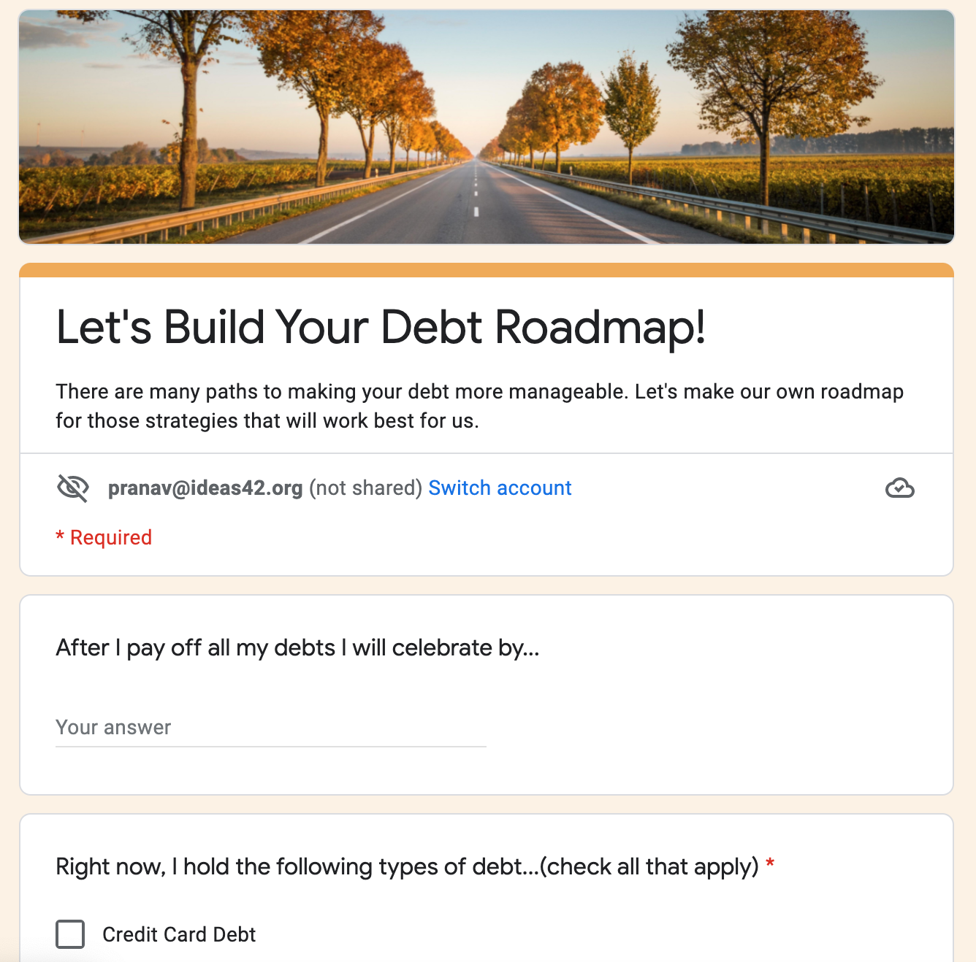
Creating a Debt Roadmap
We’ve sent everyone a link to a form in the chat
Spend the next 5 minutes filling out this form, and make sure to click “Submit” at the end
Notes:
TIME: 5 min 0:47
Before we move on, we want to pause for a moment to have everyone capture the goals and next steps they’ve identified today.
We just sent a link out in the chat. I’ll share my screen for a moment to walk through how to fill out this short form. Follow along and answer the questions for yourself, and then when you get to the end, make sure to click ”Submit” at the end so your response is recorded.
[Walk through each field of the form while sharing your screen. After you finish, given everyone a final minute or two to complete their own. Poll if everyone seems to be done, or let people know they can finish up after the workshop, and then move on.]

Slide 34
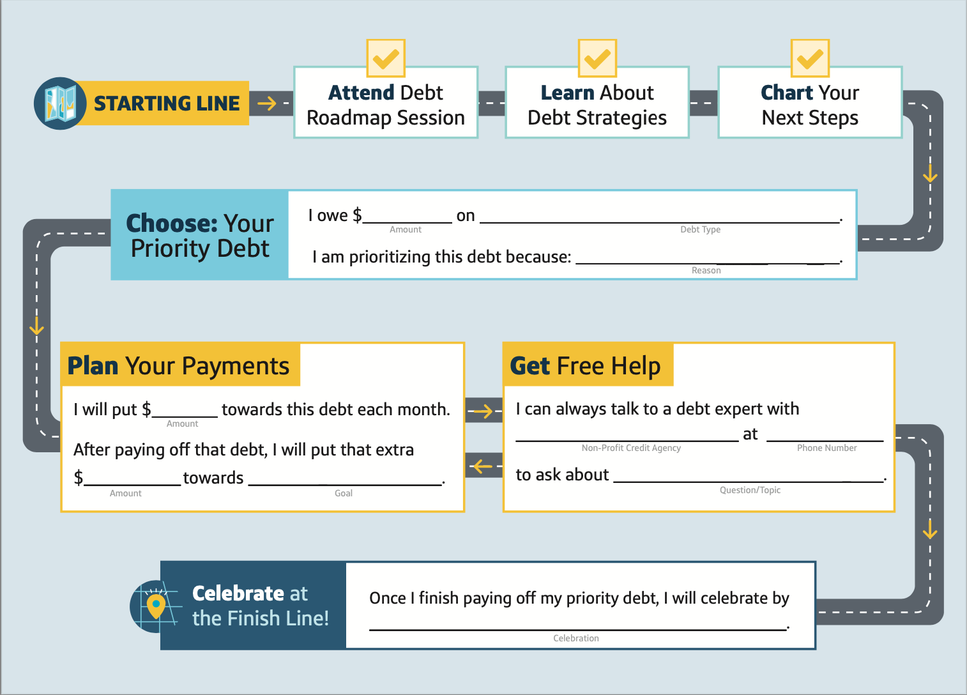
We’ll share your responses as a personalized roadmap tomorrow
YOUR RESPONSES WILL GO HERE
10,000
Federal Student Loans
Want to minimize total cost
100
[non-profit]
[Phone Number]
100
Emergency savings
a debt management plan
Buying my family dinner
Notes:
TIME: 1 min 0:48
Thank you! In the next few days, you’ll receive a personalized “roadmap” that organizes your priority debt and lays out your personalized next steps from here. This also captures what you’ve already accomplished so far simply by attending today.
The key sections of the roadmap include:
Listing our your priority debt, and how much you have left on the loan.
Writing out why you are prioritizing this debt, and how much extra money you are going to put towards it each month to pay it off.
What you’ll do with those funds after you pay the priority debt off, whether that’s another debt or a savings fund or something else you’re looking to purchase.
Where to turn for help if you ever need some additional guidance.
And what you’ll do for yourself once you finish paying off that first debt, because we all should celebrate our accomplishments.
We want to emphasize that this process takes time, sometimes months and oftentimes years. That’s okay! The point is to stay as consistent as you can, because every step you take forward gets you that much closer to paying off that debt and reaching that finish line when you can celebrate.

Slide 35
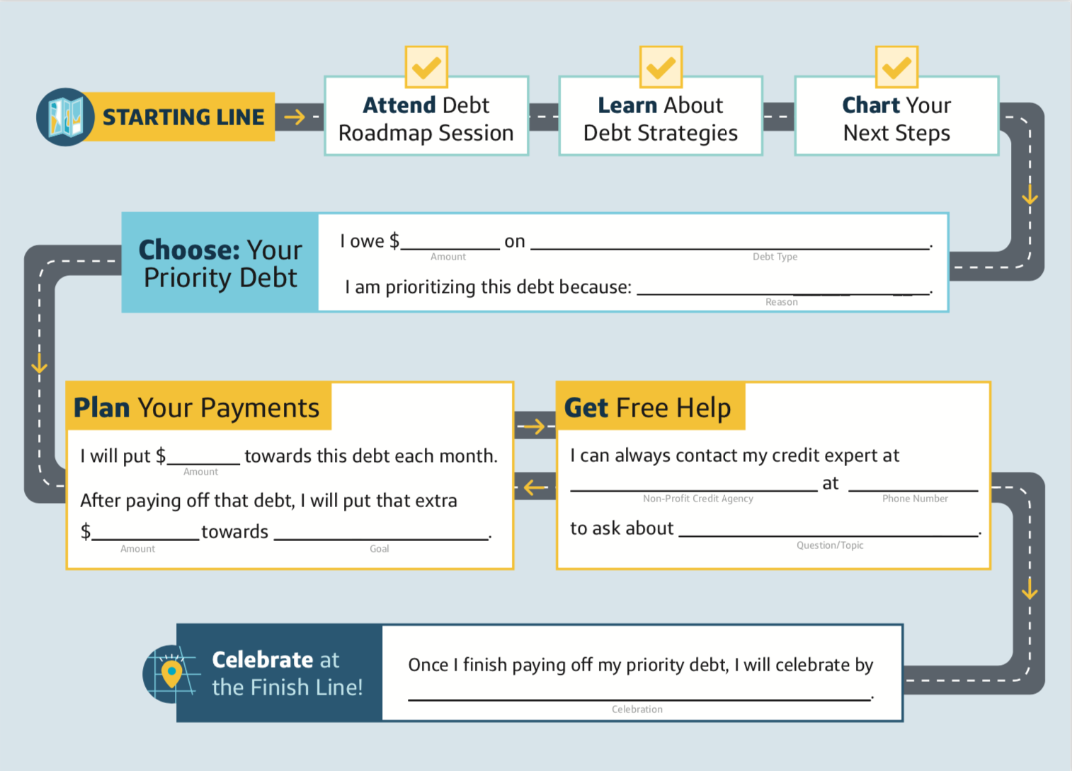
We’ll share your responses as a personalized roadmap tomorrow
YOUR RESPONSES WILL GO HERE
If I fall behind on payments, I can reach out to my lender to receive help with my situation
CCCS
(912) 691-2227
I can also talk about my options with a credit expert for free by going to www.nfcc.org/
a debt management plan
Notes:
TIME: 1 min 0:48
Thank you! In the next few days, you’ll receive a personalized “roadmap” that organizes your priority debt and lays out your personalized next steps from here. This also captures what you’ve already accomplished so far simply by attending today.
The key sections of the roadmap include:
Listing our your priority debt, and how much you have left on the loan.
Writing out why you are prioritizing this debt, and how much extra money you are going to put towards it each month to pay it off.
What you’ll do with those funds after you pay the priority debt off, whether that’s another debt or a savings fund or something else you’re looking to purchase.
Where to turn for help if you ever need some additional guidance.
And what you’ll do for yourself once you finish paying off that first debt, because we all should celebrate our accomplishments.
We want to emphasize that this process takes time, sometimes months and oftentimes years. That’s okay! The point is to stay as consistent as you can, because every step you take forward gets you that much closer to paying off that debt and reaching that finish line when you can celebrate.

Slide 36
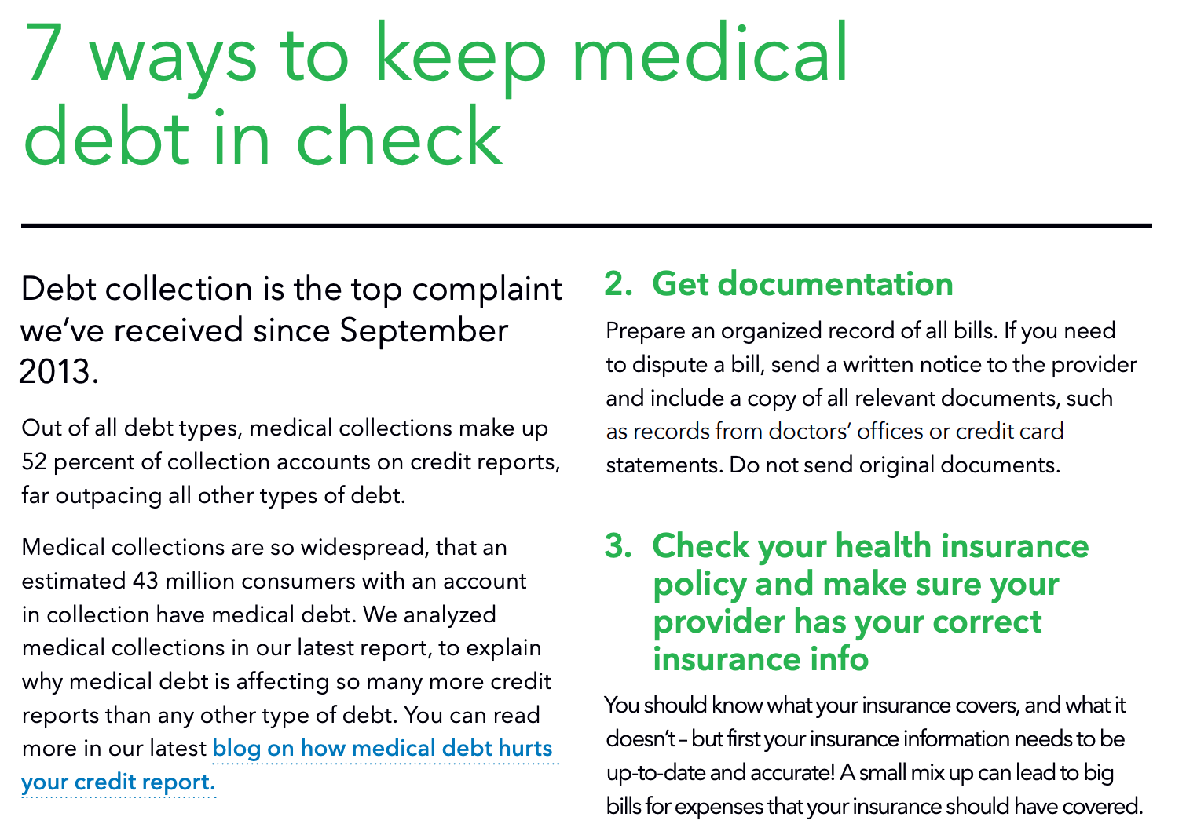
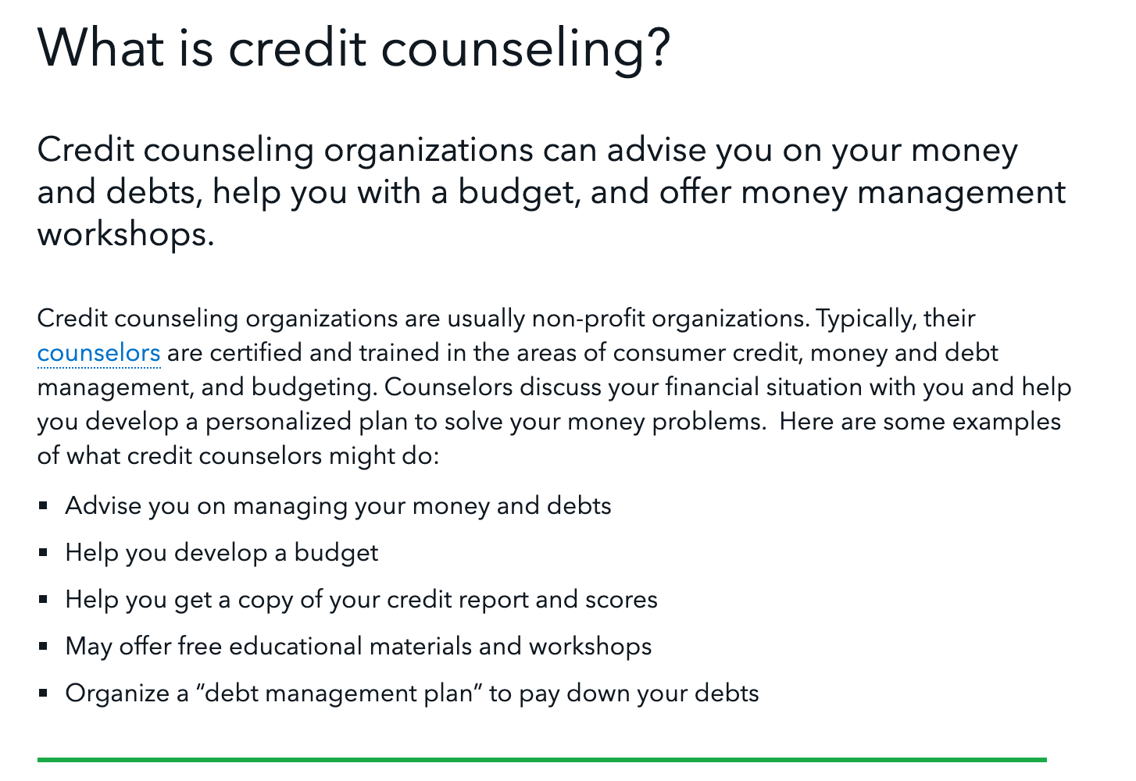
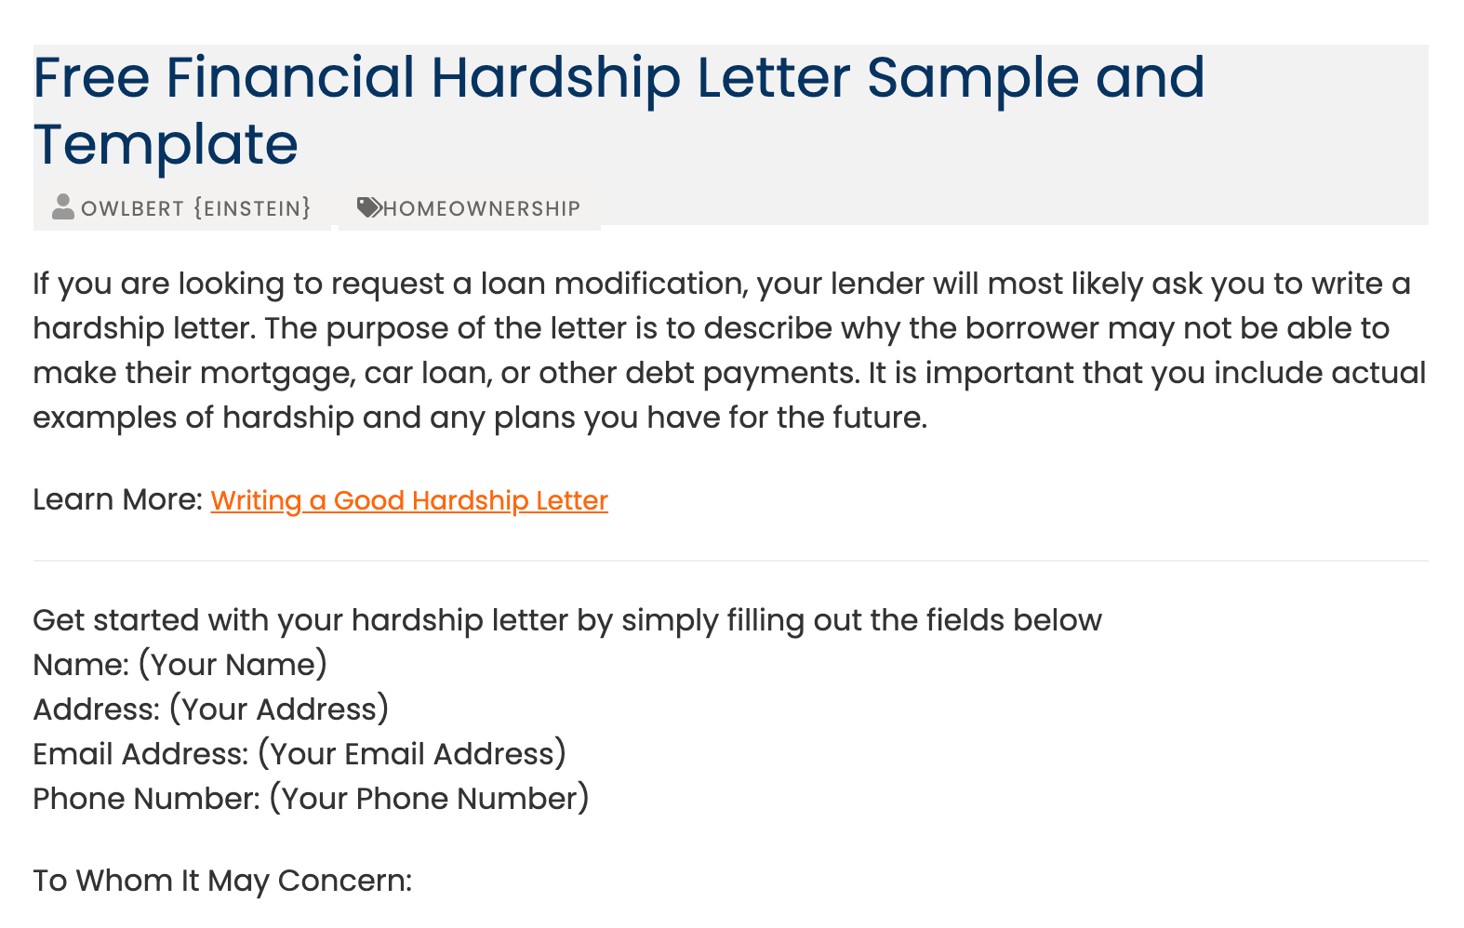
We’ll also share further resources
Tips & Tricks
Information on Resources
Templates
Notes:
TIME: 1 min 0:49
In addition, we’ll share over email some helpful resources for tackling your priority debt, including tips, templates, and some links related to what we discussed today.

Slide 37
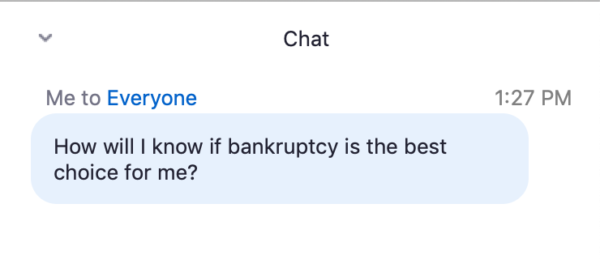
We are here as your road crew today
We’re here to answer any questions you have right now!
Please share in the chat any questions you still have, and we’ll start addressing them one at a time
Notes:
TIME: 10 min 0:59
But before we send you off with your plan and resources, we want to make sure you have a chance to have answered any specific questions you came in with today. Take a moment to write in the chat what you still want to know, and how we might be able to leave you better prepared after today’s session.
We highly encourage you to share your questions with the group, as others might have them as well, and we’d love to be able to go a little deeper today on what specifically matters most to you.
*Pre-Seeded questions if there are not specific ones from participants:
How will I know if bankruptcy is something I should consider?
My debt is in collections. What should I do next?
What are the consequences of not meeting my payments for student loans? Medical bills? Auto or home loans?

Slide 38
Thank you
Before you go, please take a few minutes to complete our post-session survey (link in the chat).
Notes:
TIME: 1 min 0:60
Thank you so much everyone for joining us. Before you go, we’d appreciate if you could take a few moments to fill out a quick survey for us on your experience today. Your thoughts help us make this workshop better for future participants.
Please click the link in the chat to get started, and make sure to hit submit at the end so your response is recorded.
It’s been a pleasure to host you all today, and we encourage you to stay in touch along your debt journey. We’ll share with you all these slides, more helpful resources, and your personalized debt roadmap in the next few days. Take care.

Slide 39
POST: Day or Two After Each Class
Review submitted intake forms, and fill out blank copies of maps for each participant with their responses
  The forms have built-in fields to be edited. After completing a form for a participant, ”Export as PDF” to save that form as a new copy.
Send participants their customized map, along with specified additional resources and a scheduling request for a one on one session
  Review the “Follow-Up Email Templates” for guidance.

